Slide 1
index
Page No. | Topic Title
1 | Title of the Project
2 | Introduction of the Project
3 | Abstract of the Project
4 | Products and Services
5 | Key Benefits of Product and Services
6 | Business Opportunities
7 | Data Flow Diagram
8 | Entity Relationship Diagram
9 | Home Page of the Website
10 | Features Product
11 | Sale Page of the Website
12 | Contact Page
13 | Registration and Login Page
14 | Checkout Page
15-27 | Html and Css Code
28 | Future Scope and Conclusion
29 | References and Bibliography

Slide 2
Introduction
In today's digital age, the e-commerce landscape is booming, presenting a lucrative opportunity to create an innovative online product selling website.
Our project, "E-Commerce Emporium," aims to design, develop, and launch a dynamic and user-friendly platform for customers to discover, browse, and purchase a wide range of products conveniently from the comfort of their homes.
Team Members: Nikki Gupta , Roshan Kumar , Shubham Kumar.
2

Slide 3
Abstract
The Online Shopping Is a web-based application intended for online retailers. The main objective of this application is to make it interactive and its ease of use. It would make searching, viewing and selection of a product easier.
The search engine provides an easy and convenient way to search for products where a user can Search for a product interactively. They can also view the product reviews and write their own reviews.
The main emphasis lies in providing a user-friendly search engine for effectively showing the desired results and its drag and drop behavior. Customers provide their complete detail of address and contact and they get their chosen products in their home.
3

Slide 4
Our Products and Services
This project represents an exciting opportunity to tap into the world of online retail and create a trusted and recognizable brand in the e-commerce space.
It is essential to remain adaptable, continuously monitor industry trends, and evolve the platform to meet the changing demands and preferences of online shoppers
Example:
Using a variety of research methodologies, Trey Research can provide support in the following areas:
Market entry strategies
Product and brand launch
Competitive intelligence data
Market analysis,
review and monitoring
4

Slide 5
Key Benefits of Product or Service
Market Research: Conduct comprehensive market research to identify profitable niches and target audiences. Analyze competitors to understand industry trends and gaps in the market.
Platform Selection: Choose the most suitable e-commerce platform based on scalability, features and budget considerations.
Product Listings: Develop informative and visually appealing product listings with high-quality images, detailed descriptions, and pricing information.
Analytics and Feedback: Implement analytics tools to track website performance and gather customer feedback to drive continuous improvement.
Example:
Investment in market research is an investment in your product’s success!
Know your customer
Know your competition
Timing is everything
Track and adjust
5

Slide 6
Business Opportunities
"E-Commerce Emporium" aims to provide a seamless online shopping experience, offering a wide range of products that cater to diverse customer needs. By prioritizing user-friendliness, security, and marketing effectiveness, the project aims to capture a significant share of the growing e-commerce market.
Example:
Contoso, Ltd. has several new products in research and development that are scheduled to go to market in future.
Now is the time:
to identify the target market for these products.
to understand how to best brand and position them.
to identify competitors and benchmark their success.
6

Slide 7
Data Flow Diagram
Customer Registration
Customer Report
Customer Info
Item detail
Customer detail
Categories
Add item info
Add to Cart
Add to Cart
Item detail
Item detail
Order Processing
Customer
Checkout
Sales report
Order Tracking Number
Admin
Order Detail
Tracking Number
Order Tracking
Update Tracking
7

Slide 8
Entity Relationship Diagram
Phone
Name
F. Name
L. Name
has
Address
Customer
Online Shopping
belongs to
does
Amount
Model
Payment
P.name
Product
Payment Type
Price
done for
Quantity
added to
Cart
made of
Cart Item
Total
Cost
8

Slide 9
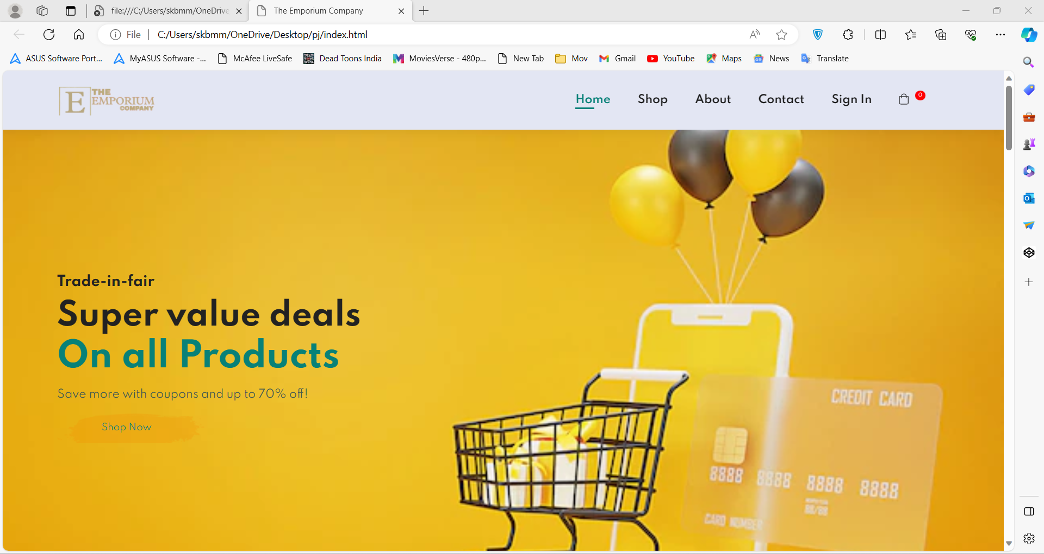
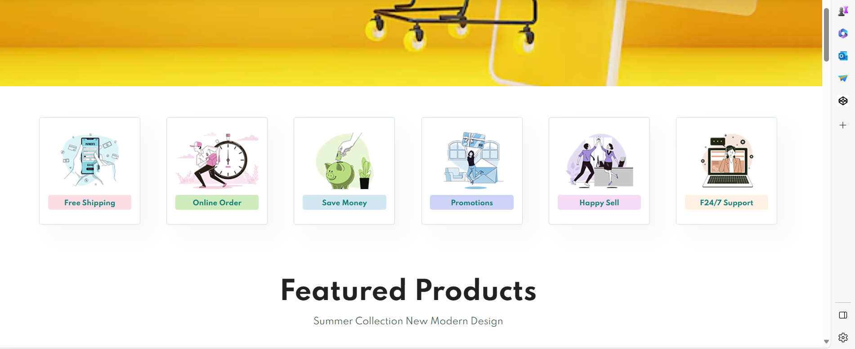
9

Slide 10
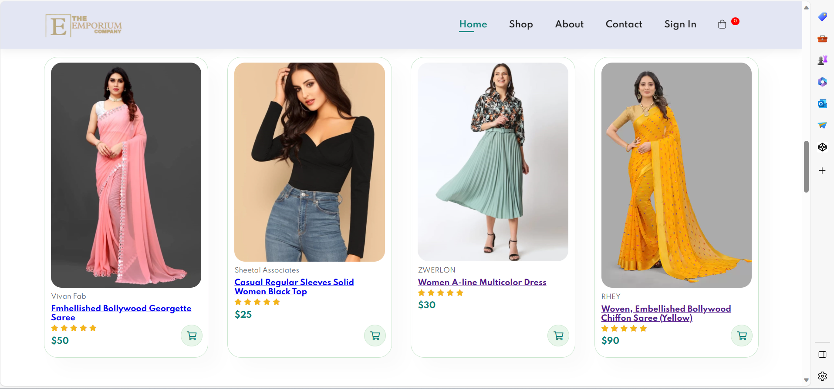
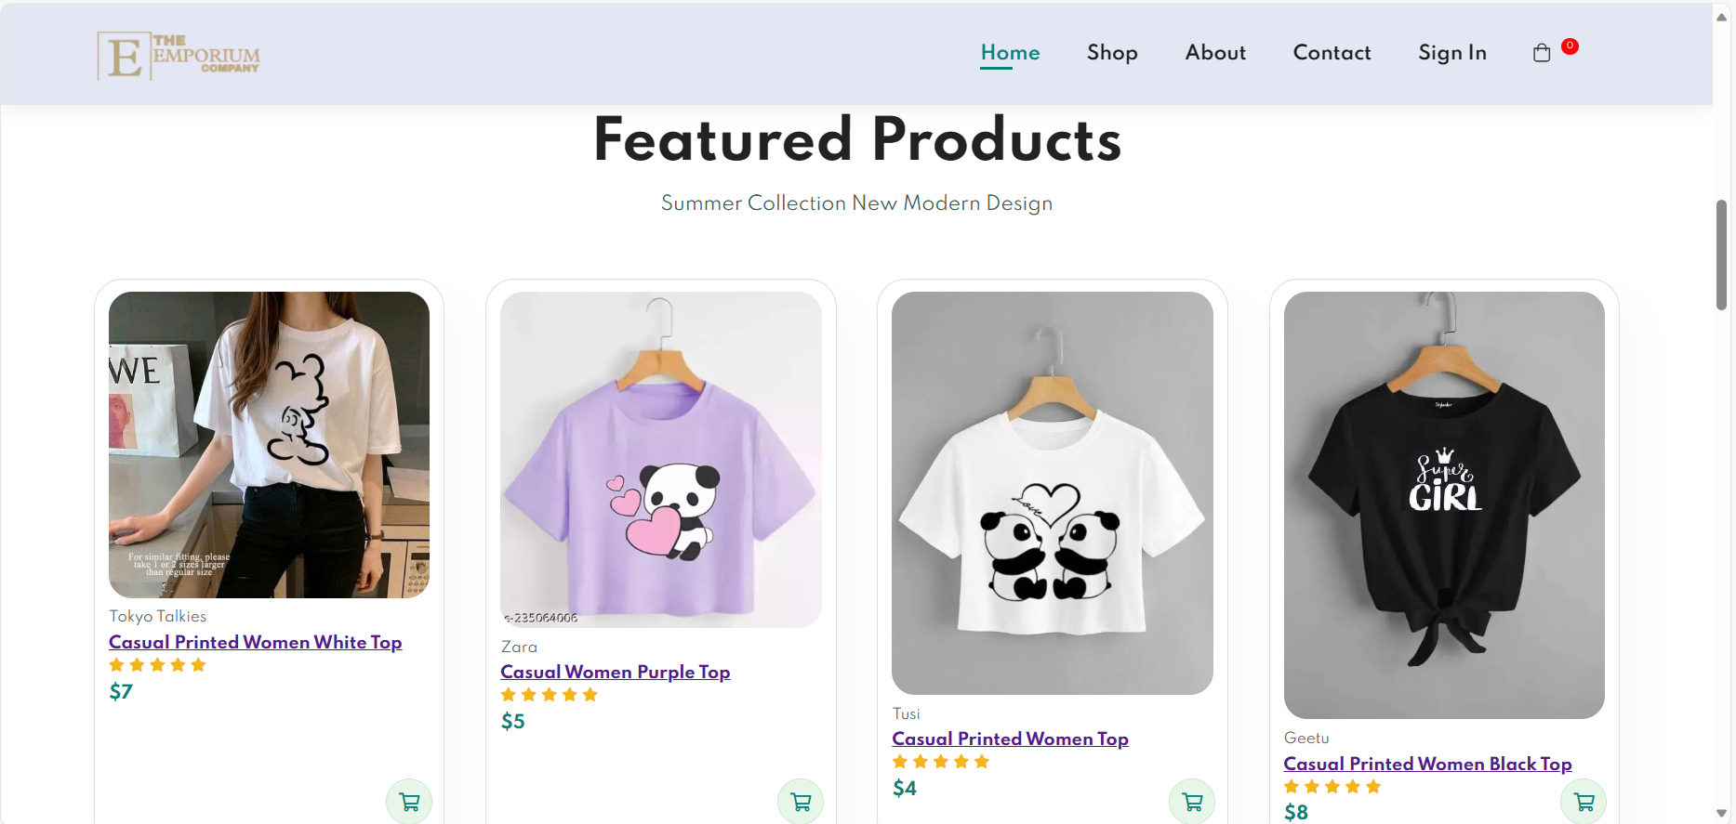
10

Slide 11
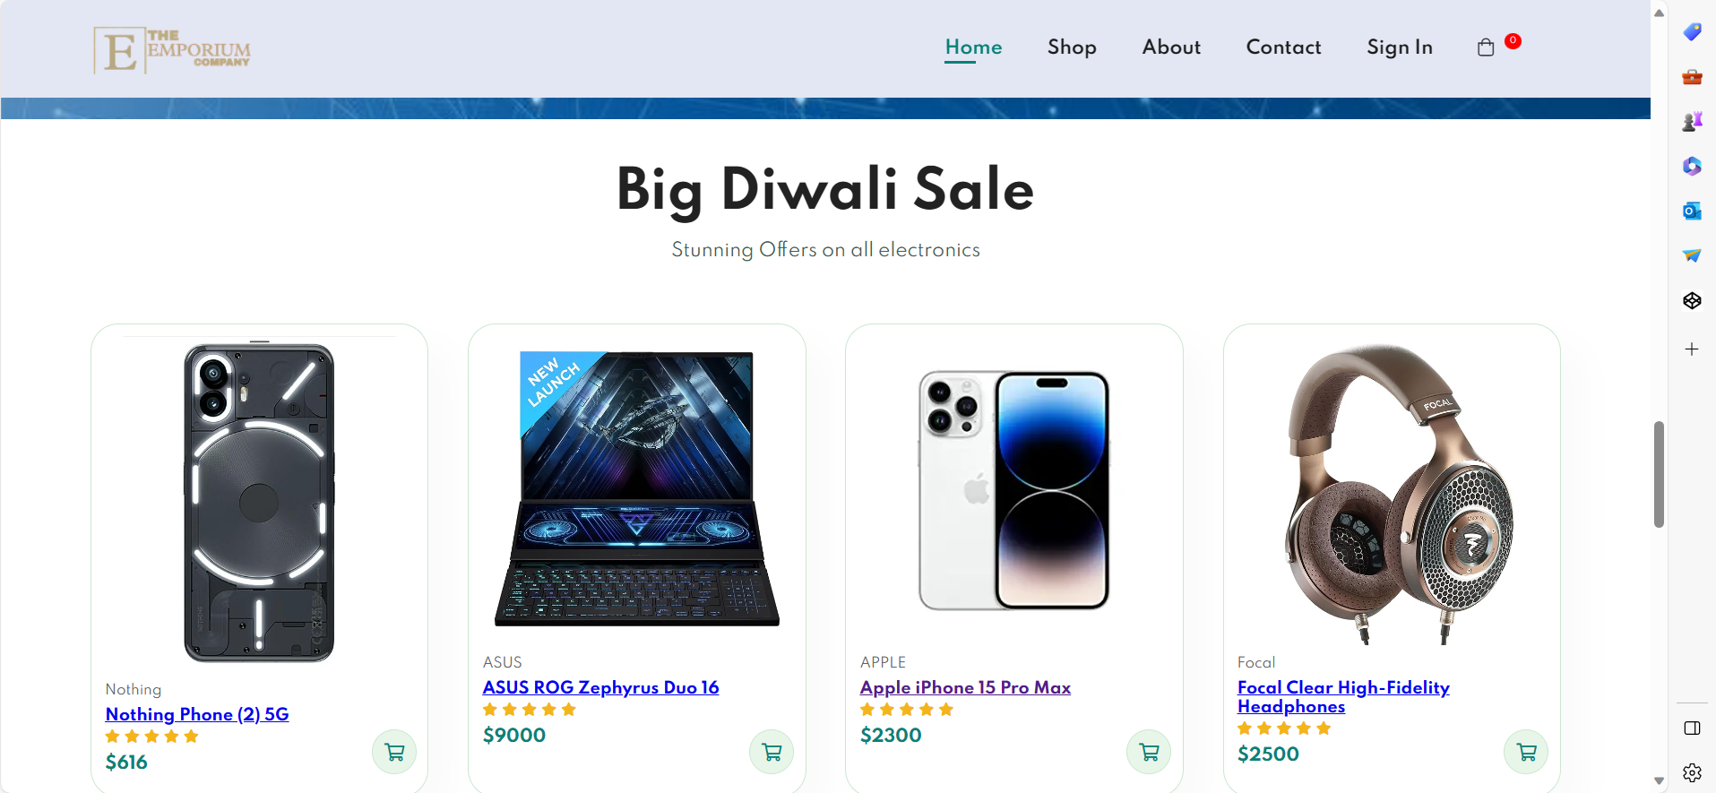
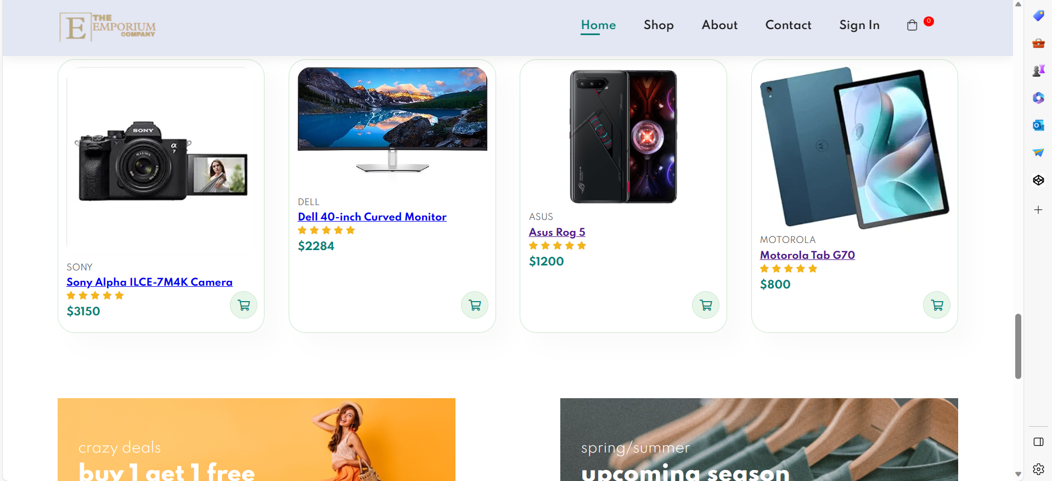
11

Slide 12
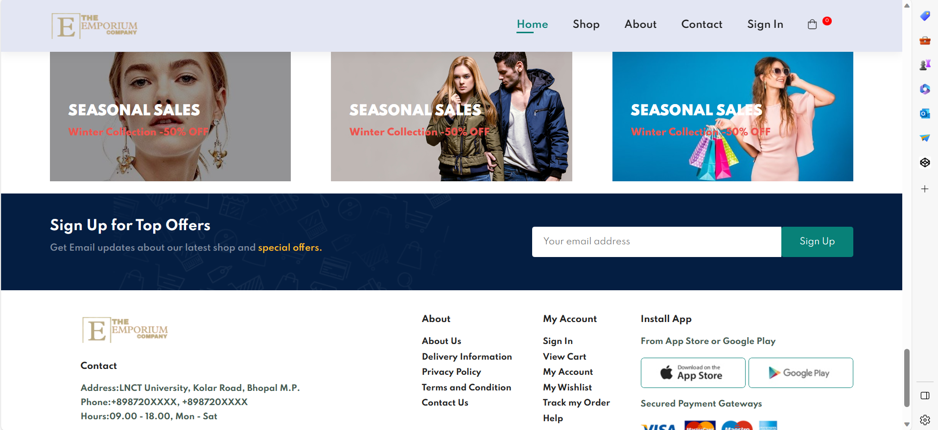
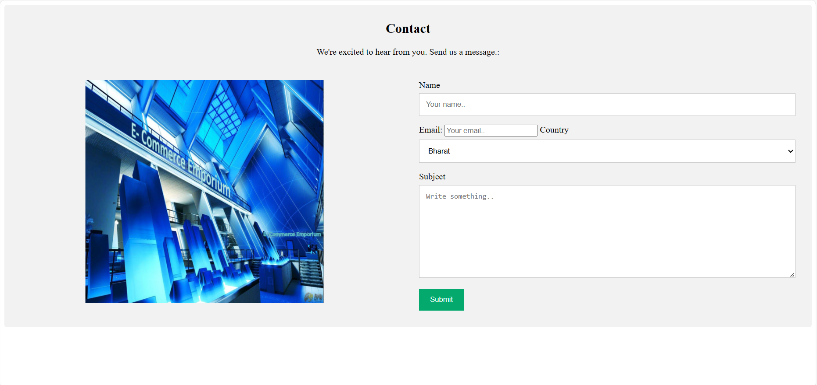
12

Slide 13
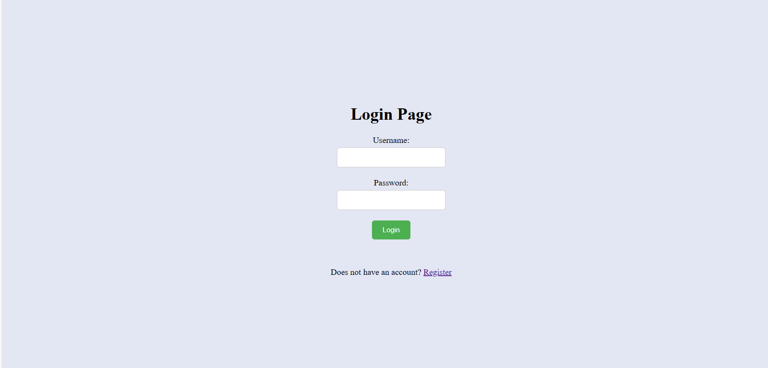
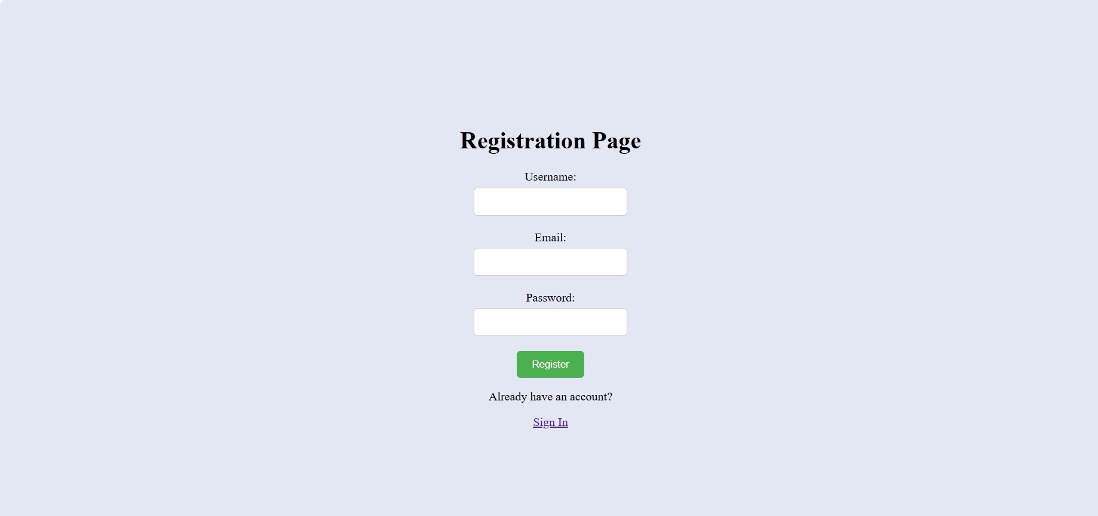
13

Slide 14
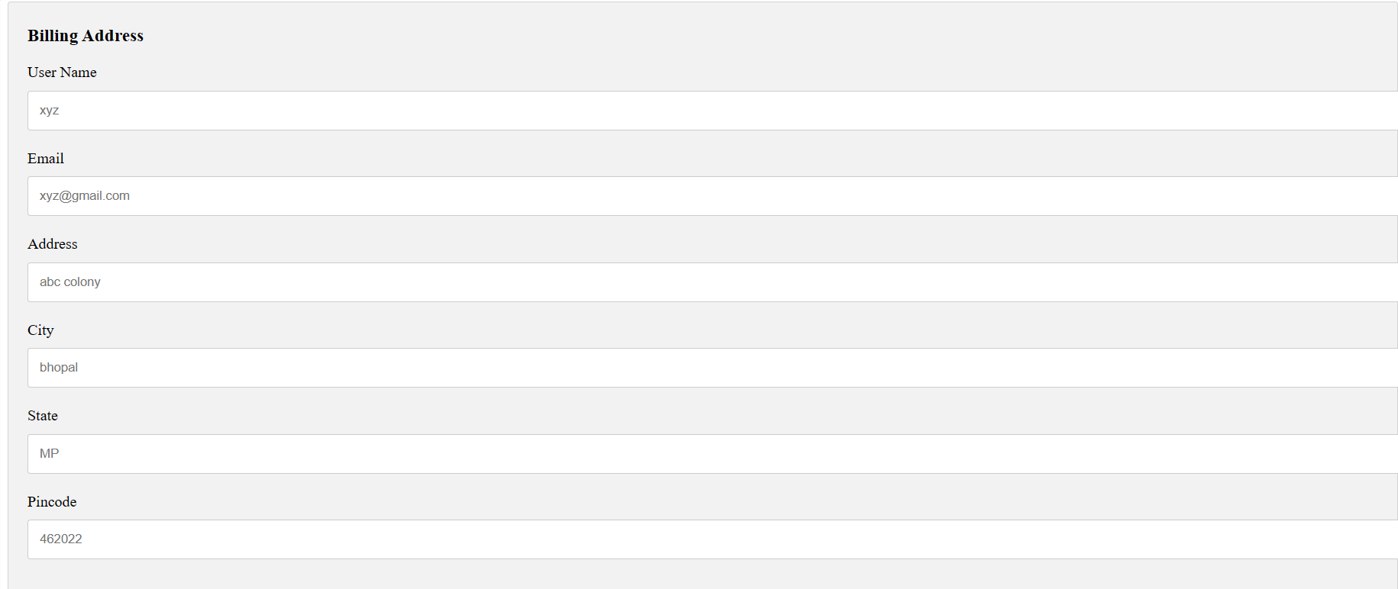
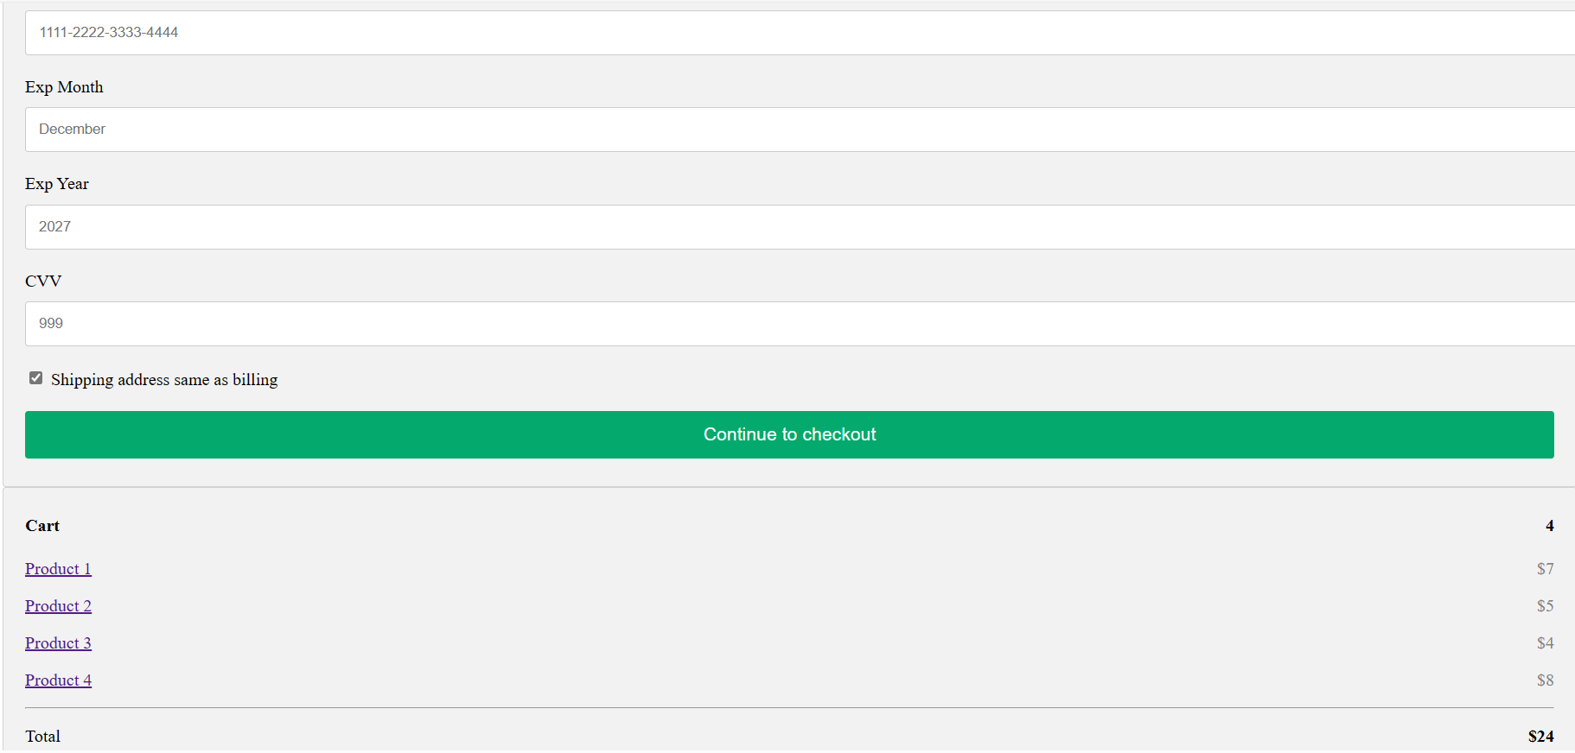
14

Slide 15
Future Scope & Conclusion
Augmented Reality and Virtual Reality: This might involve virtual try-on for clothing or accessories, 360° product view, or virtual showrooms.
Online shopping is the best way to purchase any item but be careful because there may be some fake products on different sites.
Only purchase those items which can be recognized easily that item is fake or not.
But not worry, on my site you will get all items genuine and trusty, just check once here before buy anywhere.
28

Slide 16
References and Bibliography
Google for problem solving
Ramus, K. and Nielsen, N. A. (2005). Online grocery retailing: What do consumers think? Internet Research, 15(3), 335-352.
https://www.thehindu.com/real-estate/the-future-of-indian-retail-postcovid/article31703508.ece
Databse Programming with Java Script
Frontend with Html and Css
https://www.jiomart.com/
https://www.JSP.net/
https://www.w3schools.com/, Rachita Ota, Sushree Sangita Ray & Rahul Kumar.
https://getbootstrap.com/docs/5.3/getting-started/introduction/
29

